Slide 1
FRB Update
William Huang
(7/2/2020)

Slide 2
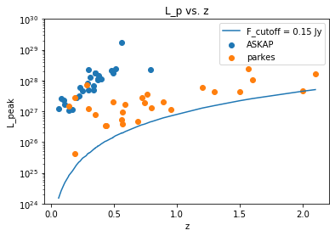
L_p vs. z, different colors
There are no FRBs from CHIME because I had initially removed them because their S/N = 0. In the future, I will add them in and set their S/N = 6.

Slide 3
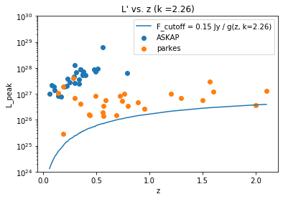
Updated L’ versus z graph
I also updated the L’ versus z graph, using L’ = L/g(z), changing the truncation line so it evolves with g(z), as well as using different colors for the different instruments.

Slide 4
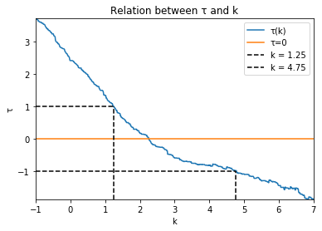
Updated tau as a function of k
Using the evolution of the truncation lines, I obtain different values of k corresponding to values of tau. The [-1,1] range of tau corresponds to [1.25, 4.75] in k, with k=2.26 corresponding with tau = 0

Slide 5
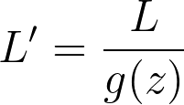
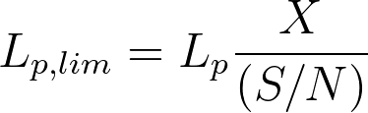
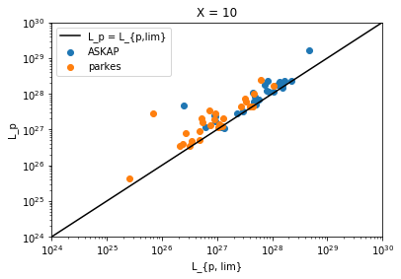
L_p vs. L_{p, lim}
I used the first equation to obtain the limiting peak luminosity, and then used the second equation to transform both L_p and L_{p,lim} with g(z). The truncation line should not need to be changed since both y and x evolve with z. Below is a graph of using X = 10, showing the difference in the two telescopes.

Slide 6
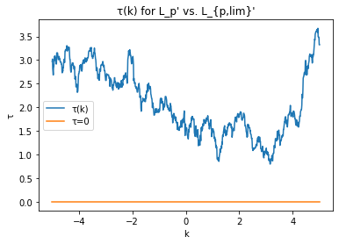
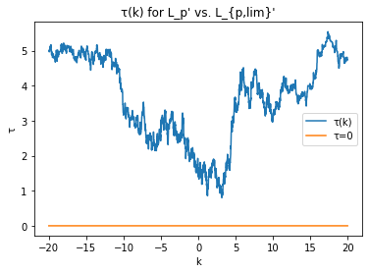
(cont.)
When running kendall tau, using L_p = L_{p,lim} as the truncation line, the kendall tau is highly irregular and never goes below 0.5. Shown below are both graphs for X = 10, with the one on the left a zoomed in version of [-5, 5], and the right with a k range of [-20, 20].

Slide 7
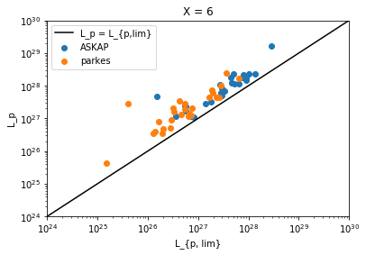
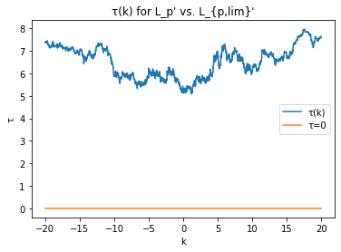
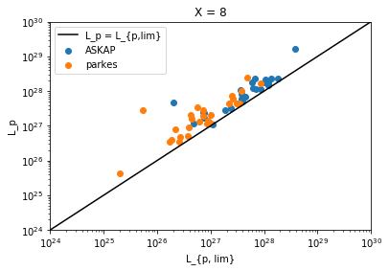
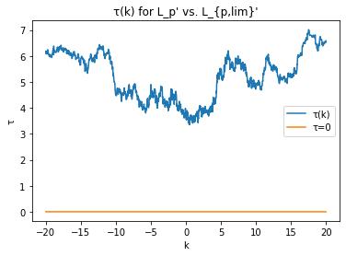
(cont.)
The graphs corresponding to X=6 and X=8 are even stranger, with kendall tau always hovering around a constant value.

Slide 8
In progress
Using g(Z)=Z^k/(1+Z/Z_c)^k
Adding FRBs from CHIME, setting any S/N = 0 to S/N = 6.

